Slide 1
Some More Cases
Tom Fardon

Slide 2
Case 3 Mrs P. Capsule
You are the medical reg on call
27 year air stewardess returned from holiday in Spain 1 week ago
Smoker
Usually well – no medication, no allergies
Presents to A&E with D&V and shortness of breath

Slide 3
On examination
Disorientated
P- 105 regular
BP – 95/60
RR – 32
The ED doctor has done a CXR which he thinks you may be interested in…….

Slide 4
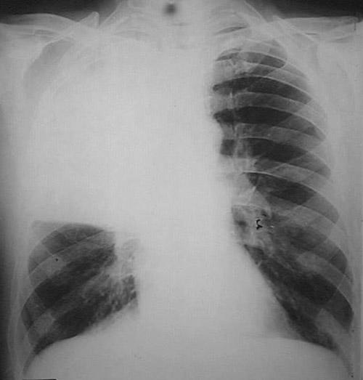

Slide 5
Describe what you see
What do you think the possible causes are?

Slide 6
Differential list
LIKELY
Streptococcus
Legionella
Staphylococcus
LESS LIKELY
TB
Mycoplasma
Viral
Klebsiella
Haemophilus

Slide 7
What tests are required?
Blood tests
U&E, FBC, CRP
Cultures and sera
ABG
Other tests
Urinary Ag
Sputum

Slide 8
Immediate results
Hb – 12.4
WCC – 19.8
Plt – 401
CRP – 412
Urea – 11.1, Cr – 135
What do you make of all these results?
pH – 7.27↓
pO₂ – 7.9↓
pCO₂ – 3.5↓
HCO₃⁻ – 16.4↓
HYPOXIC RESPIRATORY FAILURE
METABOLIC ACIDOSIS

Slide 9
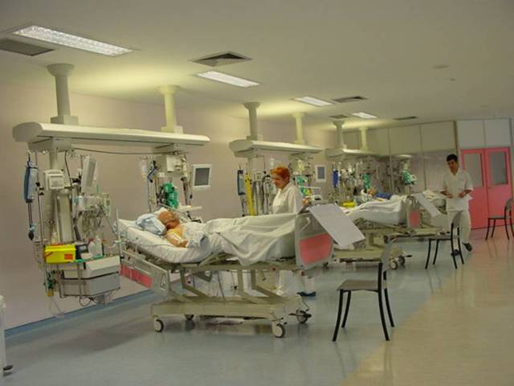
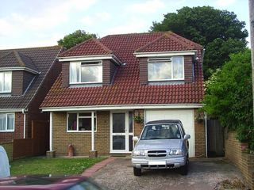
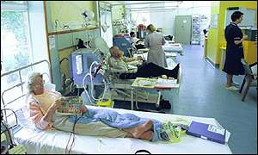
Where should this lady be treated?
WHY?

Slide 10
CURB-65
Confusion
Urea >7
Respiratory rate >30
Blood pressure <90/60
Age over 65

Slide 11
What antibiotic regime would you her?
Oral amoxicillin
IV cefuroxime and metranidazole
IV augmentin and clarithromycin
IV gentamycin and oral penicillin
Oral amoxicillin and clarithromycin
IV teicoplanin and ceftazadime

Slide 12
What antibiotic regime would you her?
Oral amoxicillin
IV cefuroxime and metranidazole
IV augmentin and clarithromycin
IV gentamycin and oral penicillin
Oral amoxicillin and clarithromycin
IV teicoplanin and ceftazadime

Slide 13
While you have been making your mind up, she has taken a turn for the worse! The A&E sister asks you to see the patient urgently.

Slide 14
Patient condition
Respiratory rate now 6
Semi-conscious
Sats monitor reads 82% despite “100%” oxygen via non re-breather mask

Slide 15
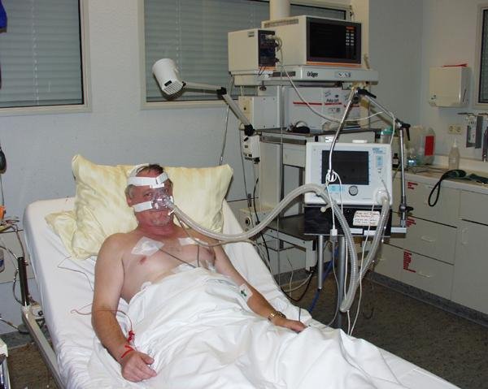
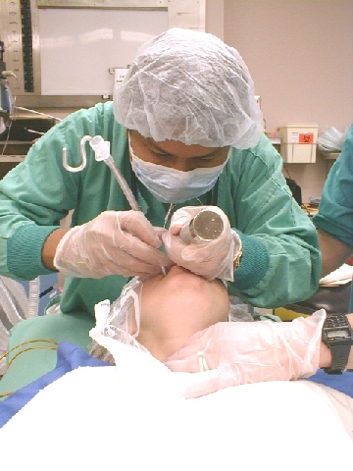
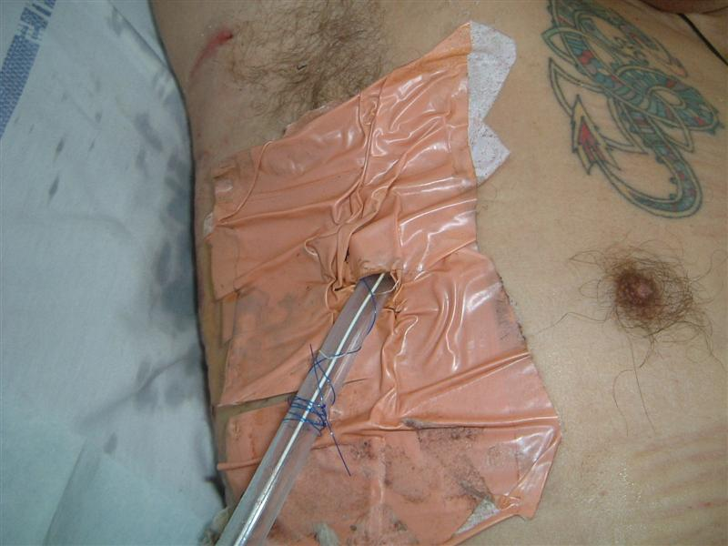
What intervention does she need now?

Slide 16
She is stabilised and transferred to ITU
She is stable and appears to be recovering
Cultures subsequently grow Streptococcus pneumoniae
She is extubated 2 days later and appears to be recovering, but then develops right sided chest discomfort and a fever

Slide 17
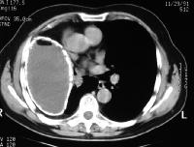
What complication has occurred?
HOW WOULD YOU FIX IT

Slide 18
Case 4 Mrs O. Bands
You are rotating through neurology as part of your FY2 year
GP wants you to assess a 37 year civil servant who is usually fit and well

Slide 19
History
Severe diarrhoea 2 weeks ago
Pins and needles in her hands and feet 5 days ago
Now difficulty getting out of chairs and walking up and down stairs

Slide 20
Examination
Reduced tone in legs
No ankle or plantar reflexes
Power 4/5 lower limbs
What do you think the diagnosis may be?
Guillain-Barré Syndrome

Slide 21
For the bonus point – what caused her diarrhoea?
Campylobacter jejuni
For the double bonus point – if the weakness started in her throat, and moved onto her arms, then legs, what’s the diagnosis now?
Botulism

Slide 22
Progress
Admitted to ward
Treated with steroids but weakness progressing over the next few days
Now bed-bound

Slide 23
As you are a respiratory physician at heart you are attuned to the possibility of respiratory involvement. What practical tests do you insist on?
Whole body plethysmography
Lying and standing vital capacity and maximal inspiratory pressure
Bronchoscopy and biopsy
Methacholine challenge test and reversibility
CT thorax

Slide 24
As you are a respiratory physician at heart you are attuned to the possibility of respiratory involvement. What practical tests do you insist on?
Whole body plethysmography
Lying and standing vital capacity and maximal inspiratory pressure
Bronchoscopy and biopsy
Methacholine challenge test and reversibility
CT thorax

Slide 25
Progress
Despite all treatment her weakness progresses and her vital capacity deteriorates
After breakfast on day 5 she is noted to be profoundly short of breath
A CXR is performed……..

Slide 26
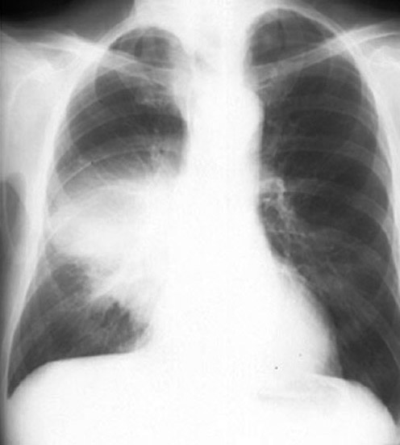
What complication has she developed and why?

Slide 27
Progress
She is transferred to ITU for mechanical ventilation
You visit her as part of rounds, and on day 3 of ventilation the intensive care doctor shows you her repeat CXR and a set of blood gas results from that morning.

Slide 28
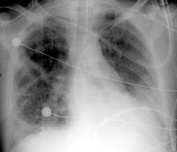
What condition has she now developed?
FIO₂ – 80%
pH – 7.36↔
PO₂ – 8.4↓
pCO₂ – 5.8↑ (a bit)
HCO₃⁻ - 28↑ (a bit)

Slide 29
Bonus marks - Do you know any treatments?
Steroids
Prone positioning
Low volume ventilation

Slide 30
Summary
Respiratory failure is when gas exchange in the lung (oxygen absorption and carbon dioxide excretion) is unable to meet metabolic demand
It can be classified in a number of ways:
Type 1 and Type 2
By mechanism
Acute and chronic (or acute on chronic!)

Slide 31
Some common causes
Type 1 (hypoxic)
Pneumonia
Asthma
Pneumothorax
PE
Pulmonary fibrosis
Type 2 (hypercapnic)
COPD
Respiratory muscle weakness
Pulmonary oedema

Slide 32
Caveats
This is not a brilliant way to classify things!!
It is better to think about the process and look at the results in the context of the patient
e.g.
asthma initially has low then high CO₂ depending on severity
ARDS can have high CO₂ when the alveolar membrane becomes danaged

