Slide 1
Clinical Aspects of Pleural Disease
Dr Tom Fardon
Consultant Physician
Respiratory Medicine

Slide 2
Learning Outcomes
Pleural effusion
  Differential diagnosis, investigations, treatment
Chest drainage
  Indications, technique, complications
Asbestos-related pleural disease
  Mesothelioma, pleural plaques
Pneumothorax
  Aetiology, treatment

Slide 3
Pleural Anatomy
Pleura:
Serous membrane covering the Lung
Double layer:
  Inner visceral - covers lung itself
  Outer parietal -covers inner surface of thoracic wall
Pleural cavity
4 ml of serous fluid
Function:
  Lubricates the 2 pleural surfaces
  Allows layers of pleura to slide smoothly over each over during respiration
  Surface tension allows lung surface to stay touching thoracic wall
  Creates a seal between 2 pleural surfaces
The two layers combine around the root of the lung – so the root of lung has no pleural coverage, the layers combine to form the pulmonary ligament, which runs inferiorly and attaches the root of the lung to the diaphragm.

Slide 4
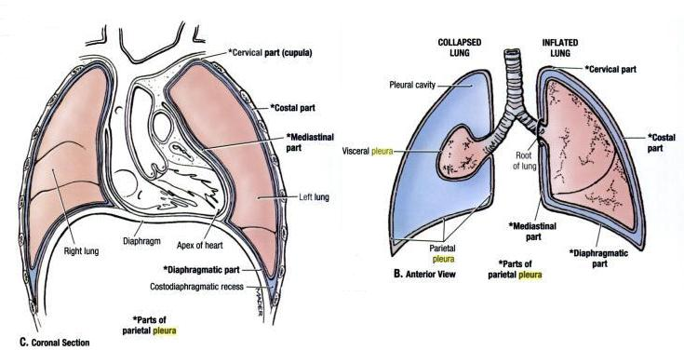

Slide 5
Pleural Anatomy
Parietal Pleura
  senses PAIN, lines inner surface of thoracic wall
  Nerve supply: Intercostal nerve, Phrenic nerve
Visceral Pleura
  sensitive to STRETCH, lines lung ext and dips into all fissures
  Nerve supply : contains vasomotor fibres and sensory ending of Cranial Nerve X for respiratory reflexes

Slide 6
Pleural effusions

Slide 7
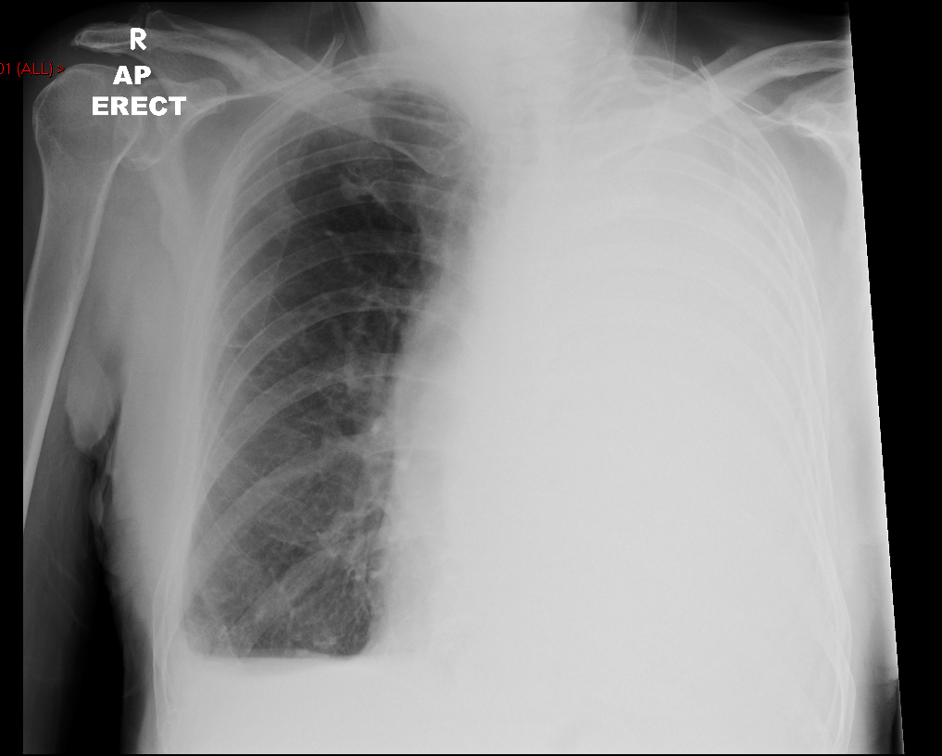

Slide 8
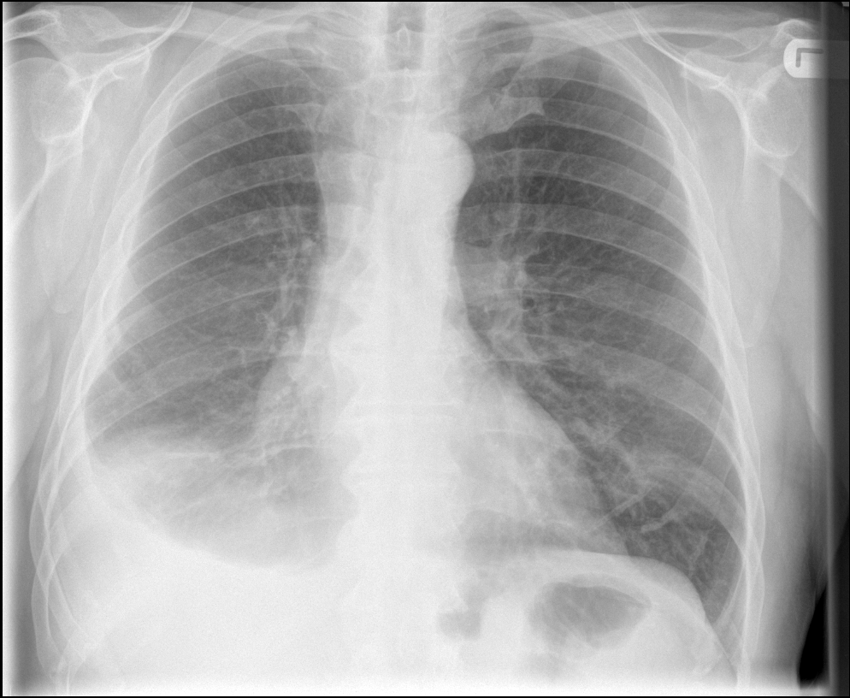

Slide 9
Pleural Effusion
Common presentation of numerous diseases
Abnormal collection of fluid in pleural space
Generally divided into Transudates and Exudates for diagnostic purposes
Does not always require drainage (e.g. cardiac failure)
Unilateral effusions are worrying in a smoker or a patient who has had significant asbestos exposure (mesothelioma)

Slide 10
Diagnosing cause of effusion
History and examination paramount
CXR (PA and Lateral)
Pleural aspirate (if not cardiac failure)
Is it a transudate or an exudate?
Other tests
  CT chest, repeat cytology, pleural biopsy (or thoracoscopy)
  Bronchoscopy has no role for sole pleural effusion

Slide 11
Analysing pleural fluid
Appearance
  Bloody
    (e.g. trauma, malignancy, infection, infarction)
  Straw-coloured
    (e.g. cardiac failure, hypoalbuminaemia)
  Turbid/Milky
    (e.g. empyema, chylothorax)
  Foul smelling
    (Anaerobic empyema)
  Viscous
    (e.g. mesothelioma)
  Food particles
    (oesophageal rupture)

Slide 12
Pleural Fluid Biochemistry
Transudates
Exudates
Protein < 30 g/L
Protein > 30 g/L
Light’s Criteria
  Pleural fluid protein: Serum protein ratio > 0.5
  Pleural fluid LDH: Serum LDH level > 0.6
  Pleural fluid LDH > two thirds upper limit of normal serum LDH
  Any of above = Exudate

Slide 13
Analysing pleural fluid
Cytology
  Malignant cells
  Differential cell count
Cell Type | Diagnoses
Neutrophils | Parapneumonic, PE
Mononuclear cells | Chronic effusions
Eosinophils | Not very helpful
Mesothelial cells | Mostly transudates, reduced in inflammatory processes (e.g. TB)
Lymphocytes | TB (>80%), sarcoid, lymphoma, rheumatoid

Slide 14
Transudate Causes
Common
Not so common
Heart failure
Liver cirrhosis
Nephrotic syndrome
Atelectasis (ITU)
Hypothyroidism
Constrictive pericarditis
Meig’s syndrome (ovarian or pelvic malignancy)
Urinothorax

Slide 15
Exudate causes
Common
Not so common
Parapneumonic
Pulmonary emboli
Malignant effusions
Rheumatoid
Mesothelioma
TB
Oesophageal rupture
Pancreatitis (↑fluid amylase)
SLE
Post cardiac injury / CABG
Radiotherapy
Uraemia
Chylothorax
Benign asbestos related effusion
Drugs

Slide 16
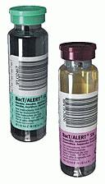
Analysing pleural fluid
Microbiology
  Gram stain and microscopy
  Culture
  AFB stain and culture
  Put in blood culture bottles for higher yield

Slide 17
Analysing pleural fluid
pH of fluid
  Normal ≅ 7.6
  < 7.3 suggests pleural inflammation
  < 7.2 requires drainage (parapneumonic / empyema)
  Do not check if frank pus!
Glucose
  LOW in infection, TB, rheumatoid, malignancy, oesophageal rupture, Lupus

Slide 18
Treatment of effusions
Treat underlying cause e.g. heart failure with diuretics
Thoracentesis (Chest drainage)
Pleurodesis (malignant effusions)
  Talc
  Surgical

Slide 19
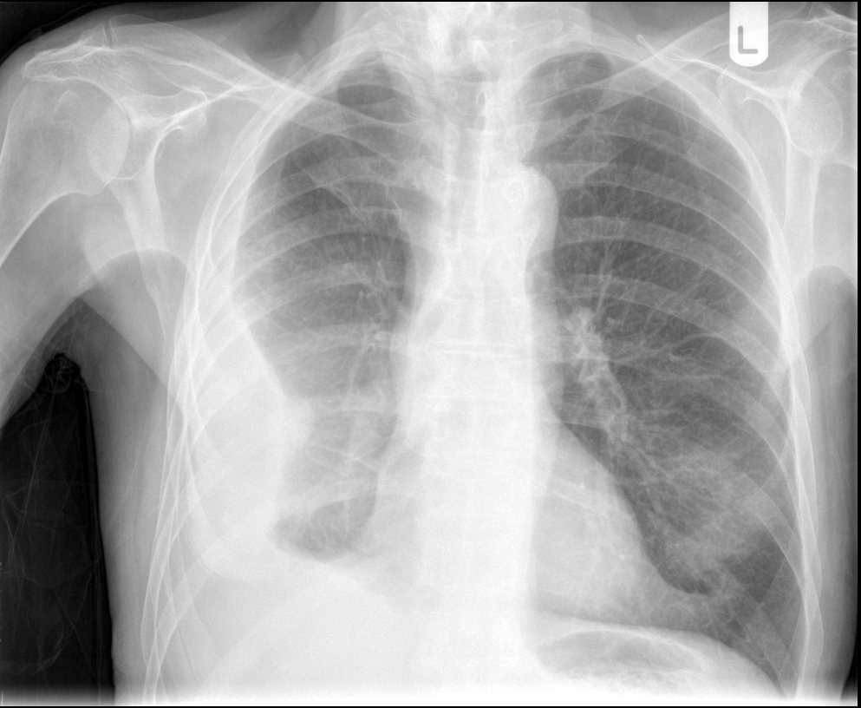

Slide 20
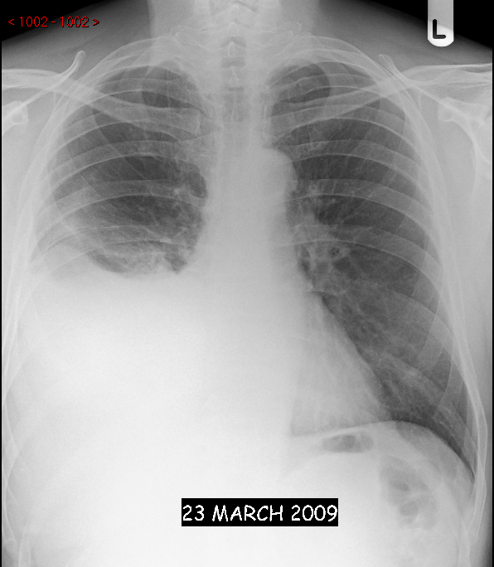

Slide 21
Chest drains

Slide 22
General points
Associated with significant morbidity, can cause death
Use ultrasound guidance when available
Must be experienced operator
Should be managed on specialist ward
Never clamp a bubbling chest drain
  Significant risk of tension pneumothorax

Slide 23
Types of Drain
Seldinger
  Guide wire technique
Large bore
  Intercostal blunt dissection

Slide 24
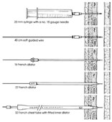

Seldinger (small bore)

Slide 25
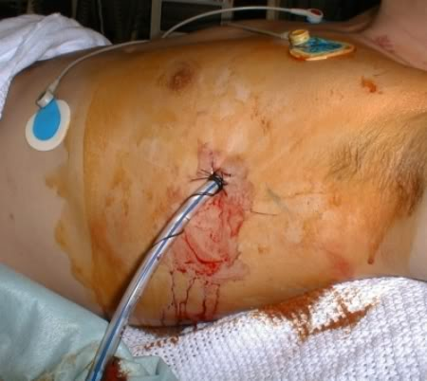
Large bore
Remember suture!

Slide 26
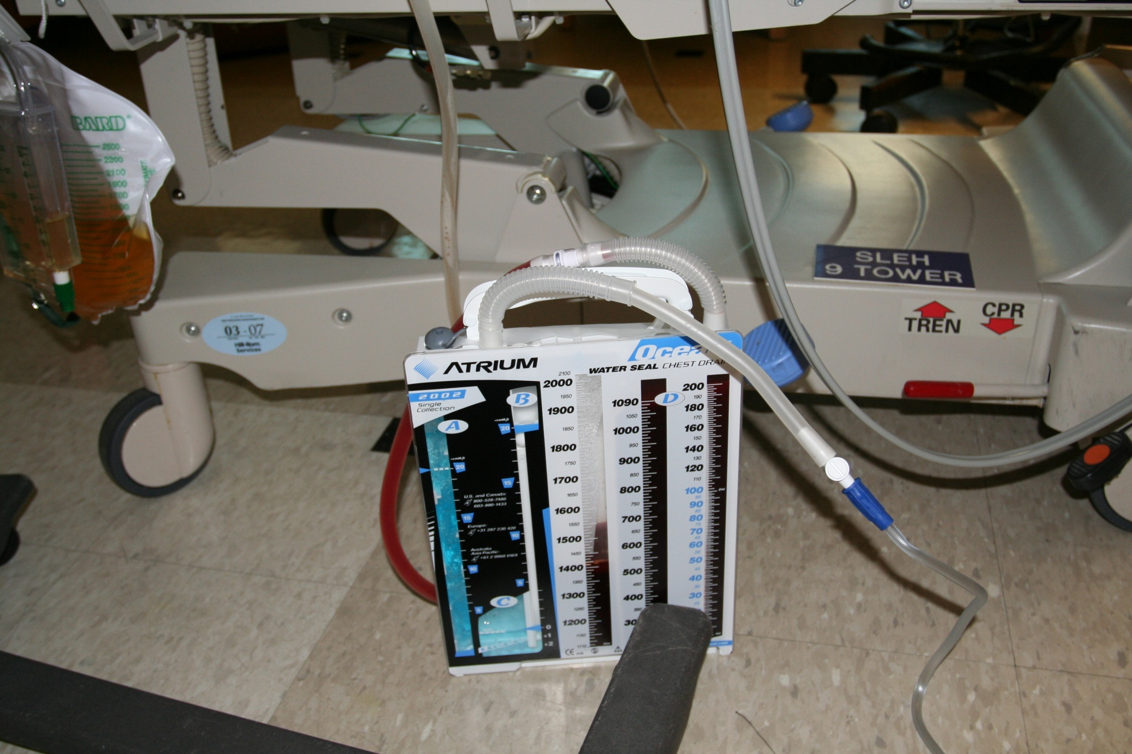
Don’t forget underwater seal

Slide 27
Indications for chest drain
Tension pneumothorax (after initial needle decompression)
Symptomatic pneumothorax
Complicated parapneumonic effusion and empyema
Malignant pleural effusion
  Symptomatic relief
  Pleurodesis
Traumatic haemopneumothorax
  Large drain

Slide 28
Complications of chest drains
Pain (most common)
Inadequate placement
Surgical emphysema
Infection
Haemorrhage
Organ damage
Re-expansion pulmonary oedema
  Large effusions that drain quickly
Vasovagal
Rarely sudden death
  Vagus nerve irritation

Slide 29
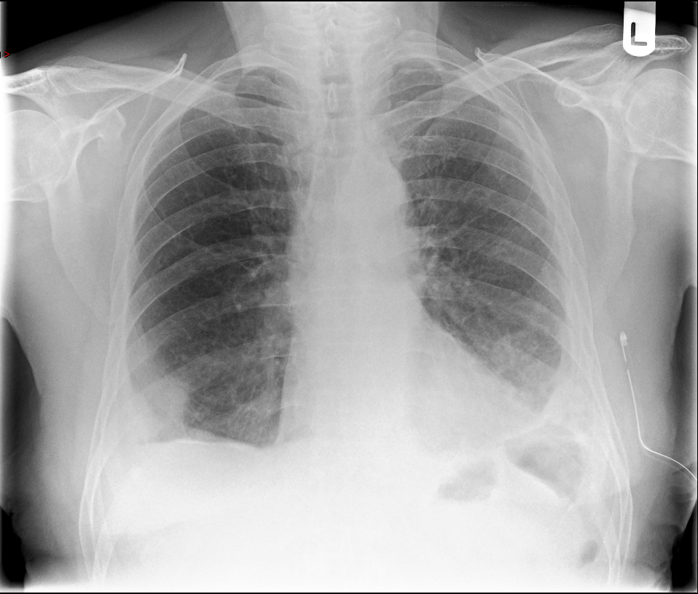

Slide 30
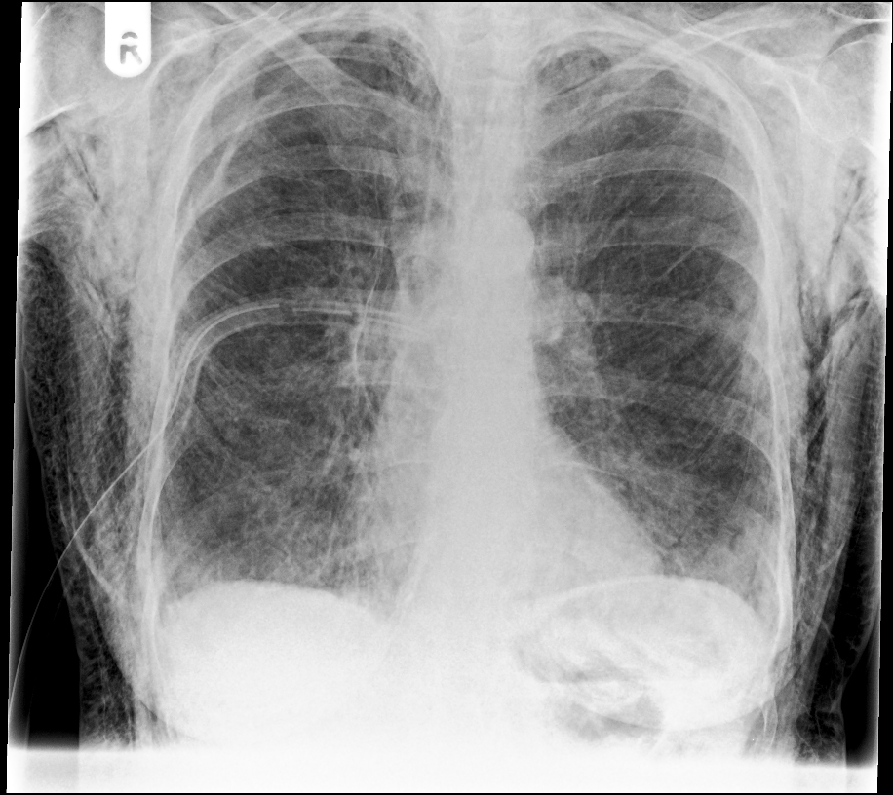

Slide 31
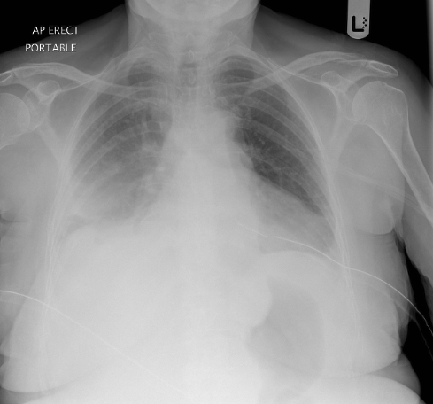

Slide 32
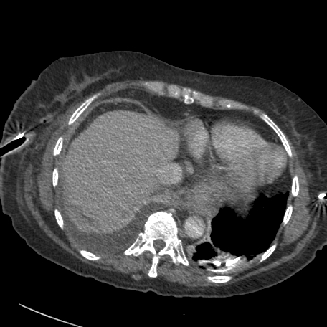

Slide 33
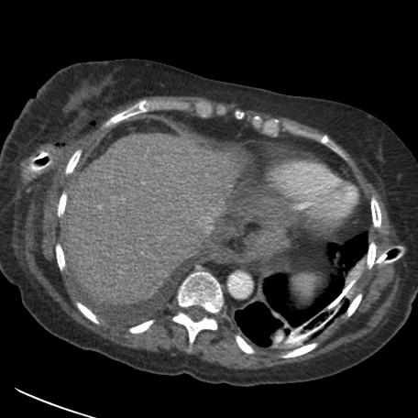

Slide 34
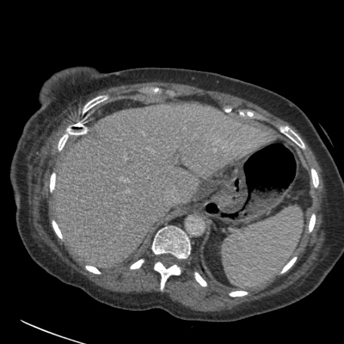

Slide 35
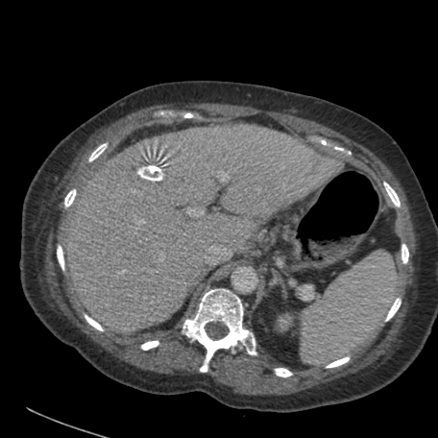

Slide 36
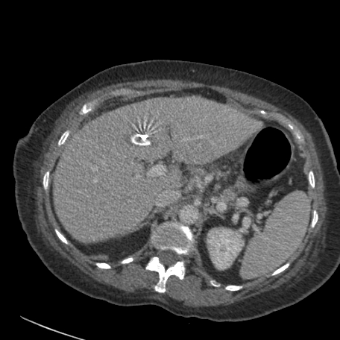

Slide 37
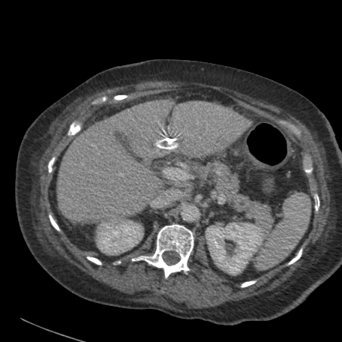

Slide 38
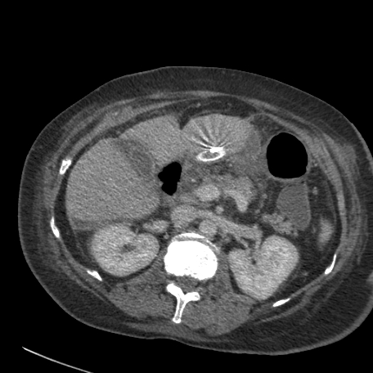

Slide 39
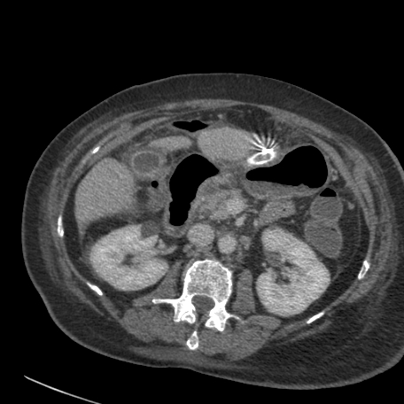

Slide 40
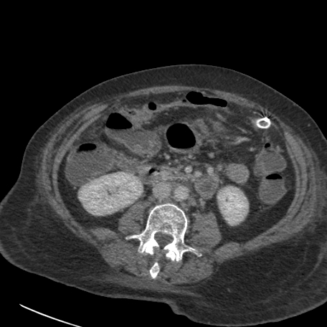

Slide 41
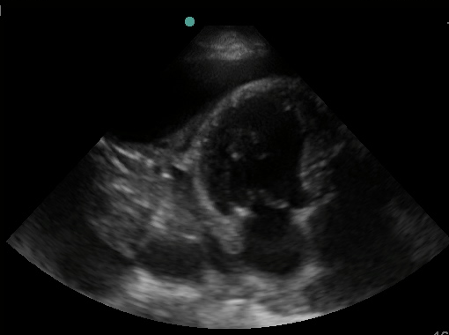
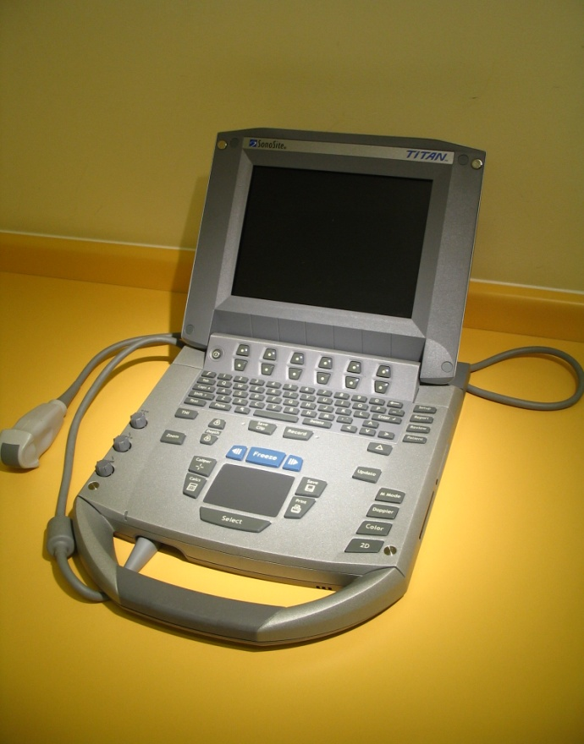
Ultrasound

Slide 42
Asbestos-related pleural disease

Slide 43
Spectrum of disease
Benign pleural plaques
Benign pleural effusions
Diffuse pleural thickening
Rounded atelectasis (folded lung)
(Asbestosis – not pleural disease)
Mesothelioma
(Lung cancer – not specifically pleural)

Slide 44
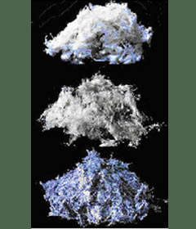
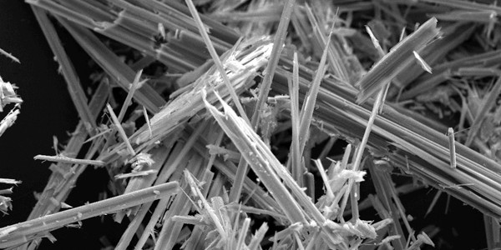
Asbestos
Naturally occurring silicate fibres
Serpentine or amphiboles
Some more carcinogenic
Exposure
  Commercial
  Domestic
Long latency period
  Up to 40 years

Slide 45
Benign pleural plaques
Common
Discrete areas of thickening on parietal pleura that may calcify
Usually symmetrical
Asymptomatic
No evidence they are premalignant
No need to follow up

Slide 46
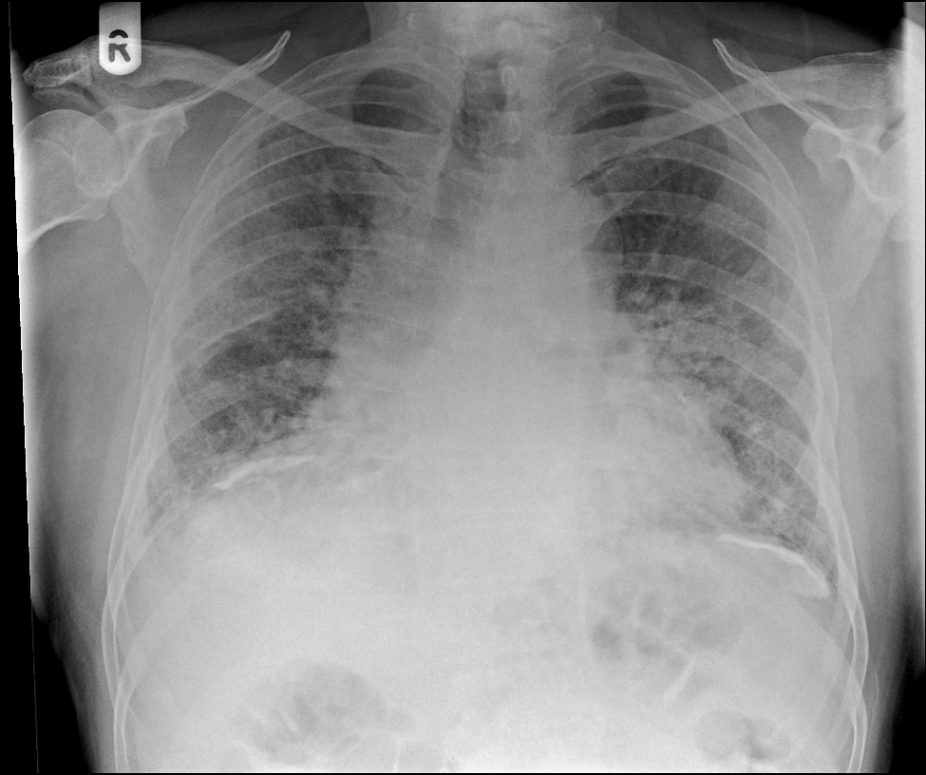

Slide 47
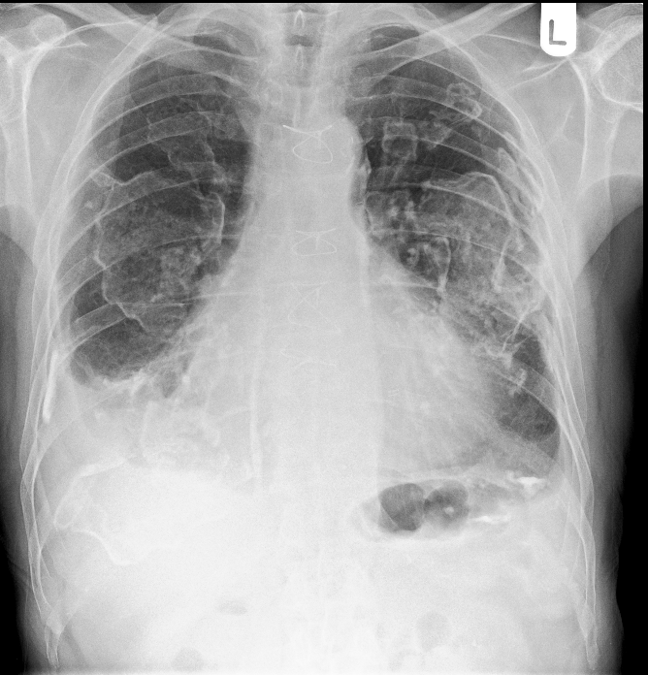

Slide 48
Benign asbestos pleural effusions
Early manifestation of pleural disease
Usually small and unilateral
Usually resolve spontaneously
Bloodstained exudate
Must exclude mesothelioma
Symptomatic treatment

Slide 49
Diffuse pleural thickening
Extensive fibrosis of visceral pleura with adhesion to parietal pleura
SOB and chest pain common
Restrictive spirometry
Need to differentiate from mesothelioma
Difficult to treat
Compensation

Slide 50
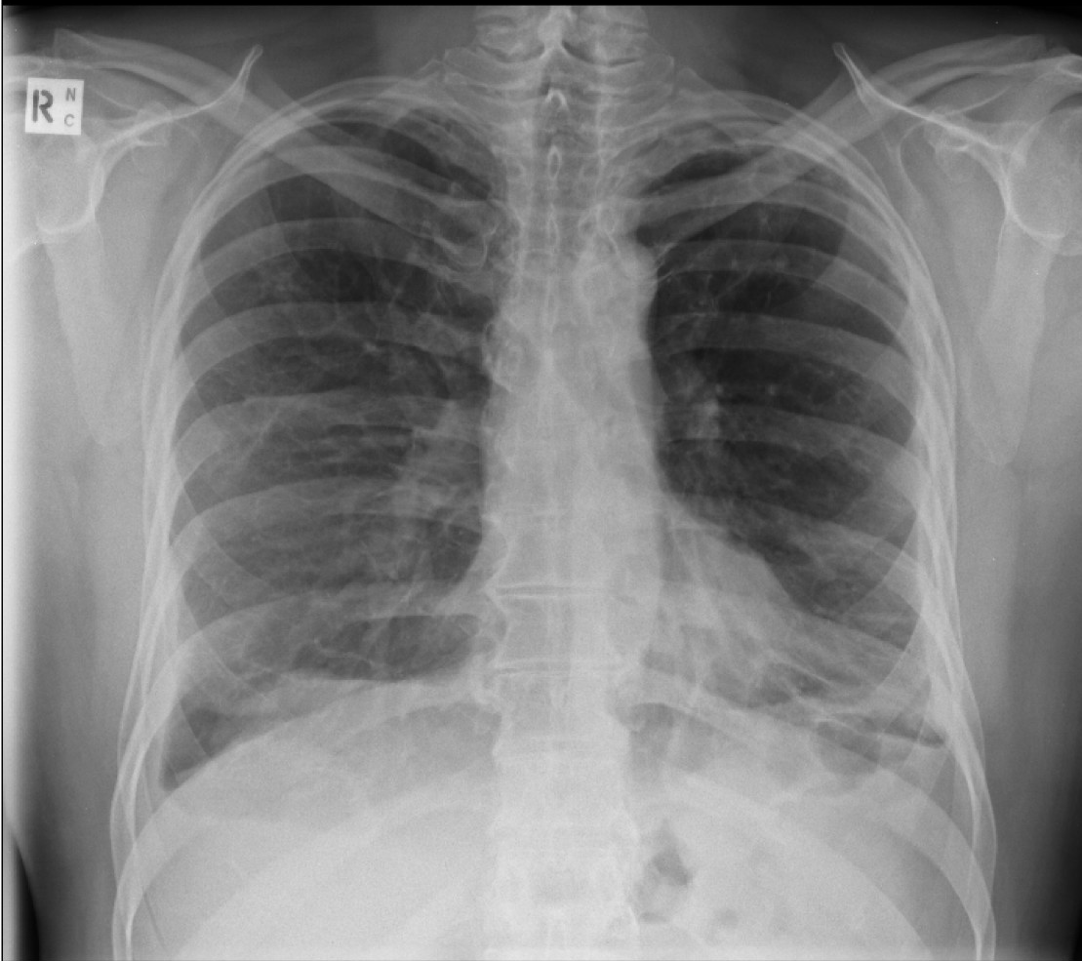

Slide 51

Mesothelioma
Malignant tumour of pleura (or peritoneum) from asbestos
Not dose related
Not associated with smoking
Chest pain / SOB / sweating
Chest wall invasion (thoracentesis sites)
Generally poor prognosis – 12 months

Slide 52
Mesothelioma
Investigations
Treatment
Pleural fluid aspiration
  Low cytological yield
  Avoid repeated aspiration
CXR and CT
  Moderate to large effusion
  Pleural nodularity
  Pleural mass or thickening
  Local invasion
  Lung entrapment
Biopsy
  Under CT/USS/Direct vision
Pleurodese effusions
Radiotherapy
  Palliative
  Prophylactic
Surgery
  Need to be very fit
Chemotherapy
  Trials mainly
Palliative care
Report deaths to fiscal
Compensation

Slide 53
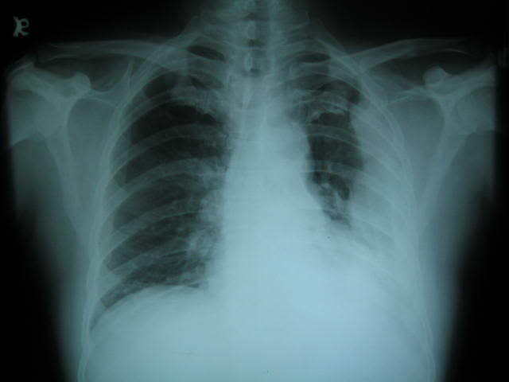

Slide 54
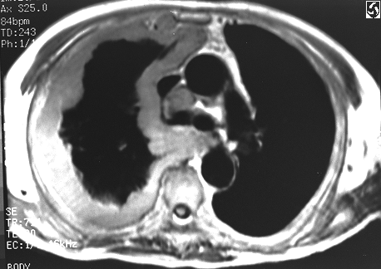

Slide 55
pneumothorax

Slide 56
Pneumothorax – Air in pleural space
9 per 100,000 annually
More common in:
  Tall thin men
  Smokers
  Cannabis
  Underlying lung disease
Primary
  Normal lungs
  Apical bullae rupture
Secondary
  Underlying lung disease (e.g. COPD)

Slide 57
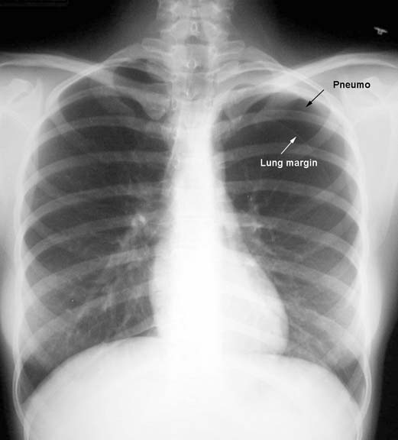

Slide 58
Presentation
SOB, hypoxia
Acute onset pleuritic chest pain
Signs
  Tachycardia
  Hyper-resonant percussion note
  Reduced expansion
  Quiet breath sounds on auscultation
  Hamman’s sign (‘Click’ on auscultation left side)

Slide 59
Investigations
Chest X-ray usually sufficient
  Small = <2cm rim of air
  Large = >2cm rim of air
  2cm rim is approx = 50% pneumothorax by volume
Arterial Blood gases
  Hypoxia
CT chest
  Useful to differentiate bullous lung disease

Slide 60
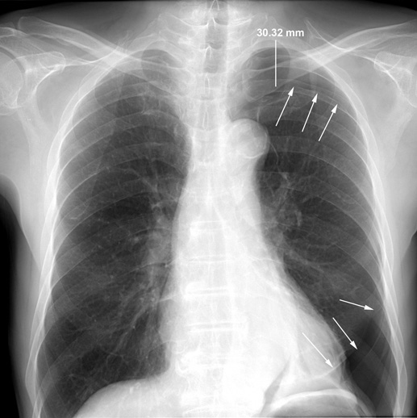

Slide 61
Management
Oxygen
No treatment if asymptomatic and small
Aspiration
  Avoids chest drain
  Time consuming
  May fail
Formal chest drain
May need suction
Surgical intervention

Slide 62
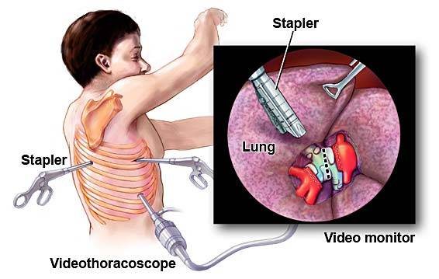
Surgical intervention
Indications
  Second ipsilateral ptx
  First contralateral ptx
  Bilateral spontaneous ptx
  Persistent air leak (>5 days of drainage)
  Spontaneous haemothorax
  Risk professions (pilots, divers) after first ptx

Slide 63

Follow-up
CXR
Discuss flying and diving after pneumothorax
Risk of recurrence
Smoking cessation

Slide 64
Tension Pneumothorax
Emergency – can lead to cardiac arrest
One-way valve, progressively increasing pressure in pleural space
Pushes other chest organs to opposite side to affected side
Acute respiratory distress
Signs
  Trachea deviated to opposite side
  Hypotension
  Raised JVP
  Reduced air entry on affected side

Slide 65
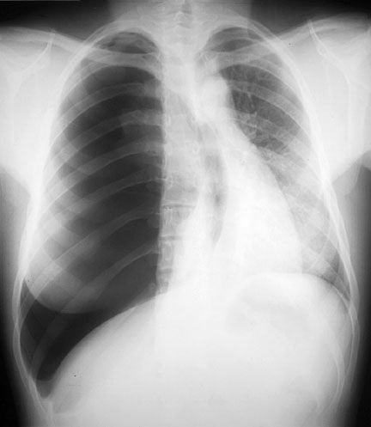

Slide 66
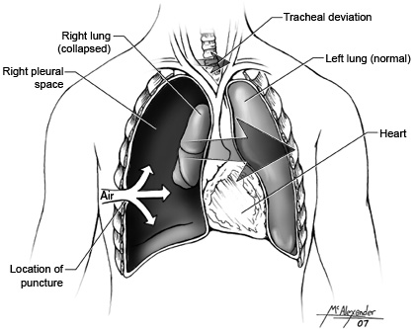

Slide 67
Treatment of Tension Ptx
High flow oxygen
Needle decompression
  Usually with large bore venflon
  Second intercostal space anteriorly, mid-clavicular line
  Hisssssssssssss........

Slide 68
